Slide 1

Salesforce Einstein Analytics & Discovery
Problem Statement
Targeting – Convert prospects into clients:
Convert ‘prospects’ into new clients. Segment the incoming funnel based on intent and leverage this
data to deliver relevant messages. Metric – Lead Conversion Ratio.

Slide 2
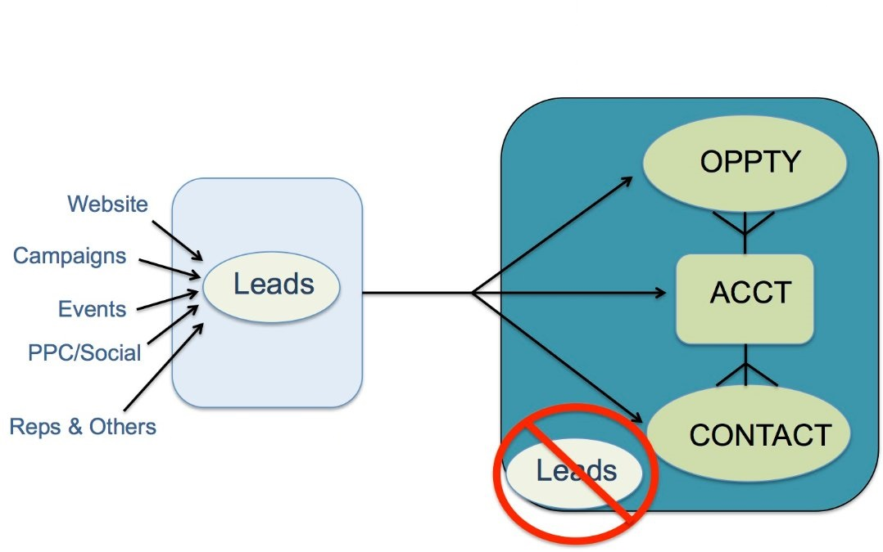
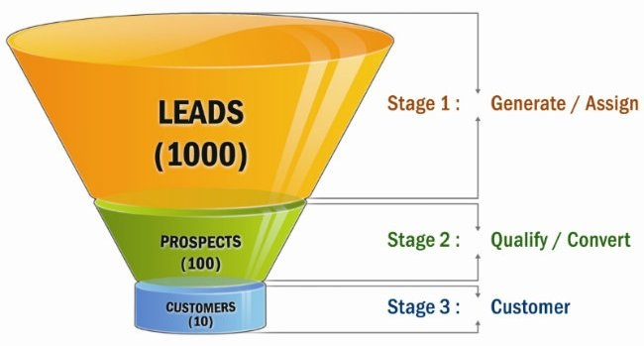
Design Architecture
Lead Conversion in Salesforce
When you qualify a lead, you can convert the lead record into an opportunity. You’ll then work your opportunity until you close the deal either by completing it or canceling it.
Qualifying a lead indicates that you believe that the lead has a use for and interest in your products, and that a sale to the lead is a definite possibility.
Some businesses choose to qualify leads more quickly than others. The exact criteria for qualifying and converting leads is part of your company’s unique business process.

Slide 3
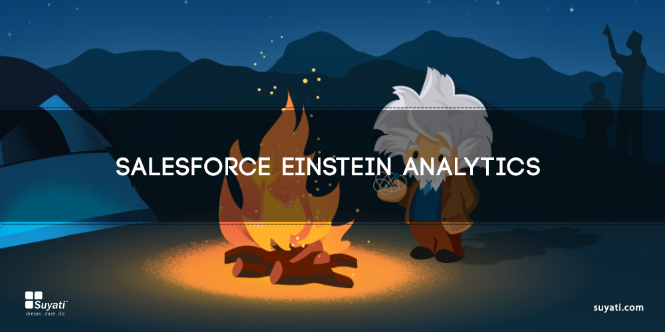
Introducing Salesforce Einstein Analytics and Discovery for Data Analysis

Slide 4
Solution Approach & Business Impact
Using Einstein Analytics and Discovery
Einstein Analytics is reliable, convenient, and gets up and running much more quickly than traditional solutions.
The platform simplifies the preparations, analyses and visualizations that turn complex raw data into intelligence, and investment into growth.
Get data analysis directly from Salesforce — or any other data source or large source— from across your business and create them as datasets by taking the suggestions from Einstein Analytics.
Analytics collects and organizes your data in datasets, lenses, dashboards, and apps. These collections, also known as “Analytics assets,” represent levels of data refinement—from raw data that’s uploaded from your source systems to highly curated, packaged views of your data.
Take suggestions from Einstein analytics and use it to create stories and hidden insights faster.
Customize your Analytics home page with all the relevant filters and the entire data changes according to the filters selected along with dashboards to continually monitor key business metrics based on the latest data.
Build custom analytics applications to solve issues for any company, in any industry. Discover and implement partner apps built on the platform that are already saving businesses time and money.

Slide 5
Solution Approach & Business Impact
Using Einstein Analytics and Discovery
Give your employees and partners a consistent view of data and access to new insights.
Embed dashboards across the Customer Success Platform with Einstein Analytics — from Sales Cloud to Service Cloud.
No more waiting for IT to install hardware and optimize software before you can ask questions or take action. With Salesforce as your CRM, analytics is built into your data.
Find hidden insights faster with Einstein Analytics, the business analytics tool built for the way you work.
Find hidden insights and sales opportunities in your business and customer data that you can take action on, right from within Salesforce.

Slide 6
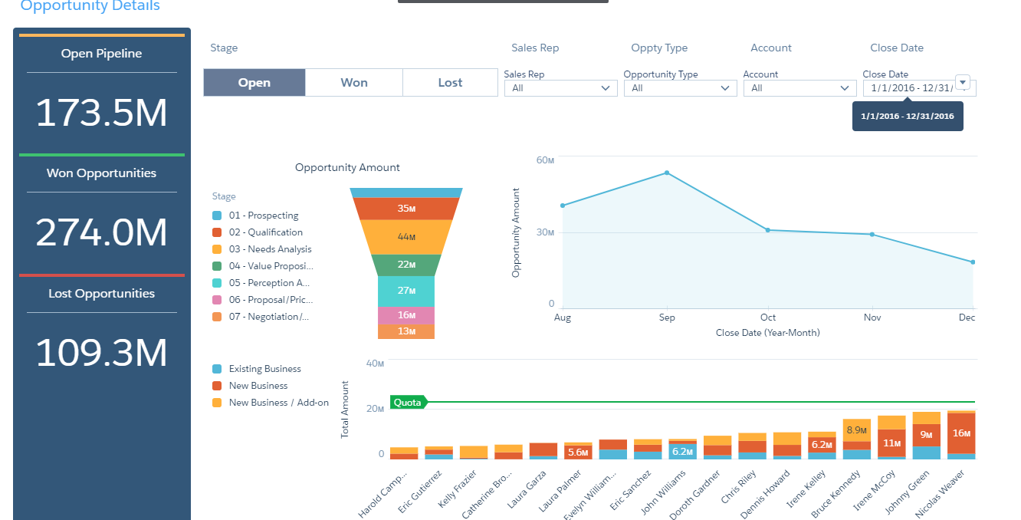
Einstein Analytics Overview

Slide 7
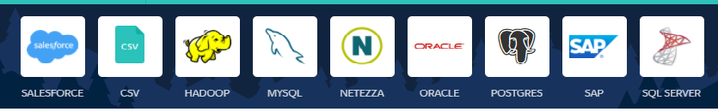
Einstein Discovery
Using Einstein Discovery
The data for analysis can be loaded from SQL, Hadoop ,MYSQL , NETEZZA,ORACLE,POSTGRES,SAP and even a simple CSV File is enough for the discovery tool to read the data for analysis.
For other databases you have a form which allows you to define the connection string, name host of the database.
Once loaded Einstein Discovery gives you an analysis like if the data in one column has spelling mistakes, the number of rows that have null values, or if there are only one row/column with one particular value
Not only does it let you analyze it but it also lets you decide to do what you want to do with it before creating a datasets as shown below.

Slide 8
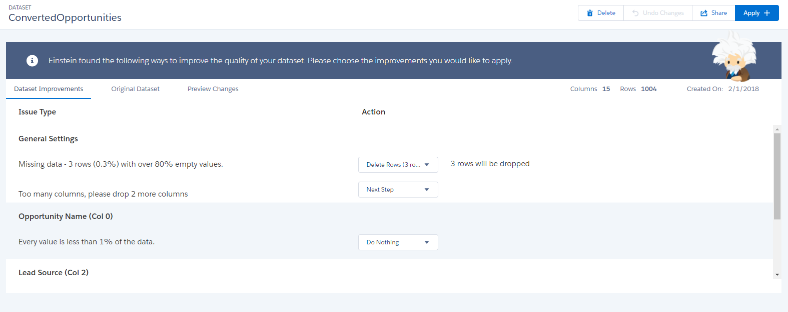
Einstein Discovery
Using Einstein Discovery
Once loaded Einstein Discovery gives you an analysis like if the data in one column has spelling mistakes, the number of rows that have null values, or if there are only one row/column with one particular value
Not only does it let you analyze it but it also lets you decide to do what you want to do with it.
You can do the following
You can do a Find and Replace
Do nothing.
Delete the row with empty values and remove a duplicate column

Slide 9
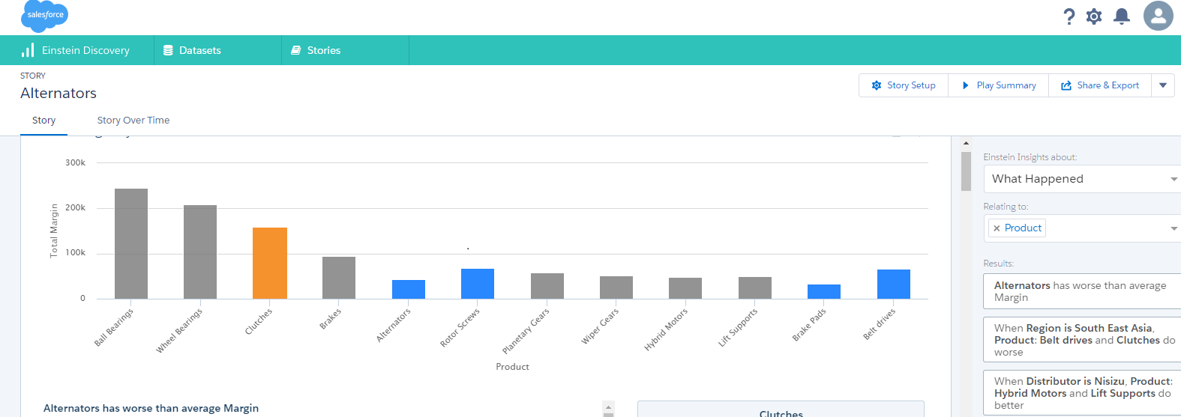
Einstein Discovery
Using Einstein Discovery
Once the data is read the stories are created with the data is analyzed.
Einstein Discovery gives you a visual presentation in terms of Bar chart and explanatory text which is an insight to the data from any of the sources.
Each insight gives you what could be the reason for less margin as in our example and lets you dig further in to what happened and why it happened along with how can you improve our margin for our data.

Slide 10
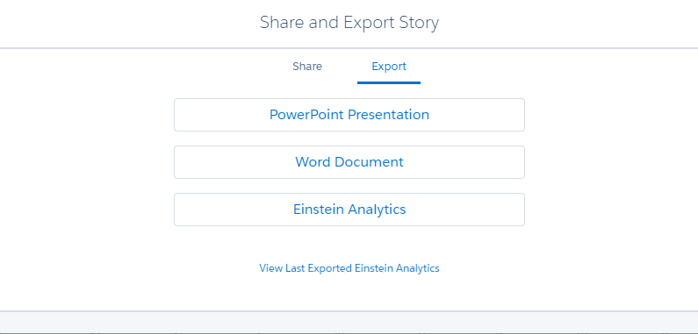
Einstein Discovery
Using Einstein Discovery
After your analysis you can export it to a word document or a PowerPoint or Einstein analytics to display the data to your sales rep or Mangers.
The insights that are provided can also be played in the form of a video to get a better understanding of your performance for the next month or for your previous months.

Slide 11

Thank You

